Slide 1
Impact of Stephen Curry on 3 Point shooting in the NBA
Prepared BY: Mahendra nanuram Kaswan
Karthika Nambiar
Pranjal Yadav
Nijin Varghese
Manoj Kumar Mahendra

Slide 2
Objective of project:
Determine and analyze the trends of 3-point shooting before and after Stephan Curry’s arrival.
Analyze how the arrival of Steph Curry changed the trend of
3 point shooting for all 30 NBA teams , ranging 24 seasons.
Methodology
The data analysis for 3-point shooting is made by selecting 30 NBA teams within 1996-2020. The four main factors that we focus on are
3-pointers scored
3-pointers attempted
3-pointers field goal percentage and
Share of 3-pointers in total points
Excel was used to identify, analyze, interpret, and represent trends or patterns in the Data about the parameters mentioned above.
Graphical analysis and statistical tools like Histogram, Time-series plot, t-Test (Hypothesis Testing) and One-way Anova were used to explore the 3 point shooting data.

Slide 3
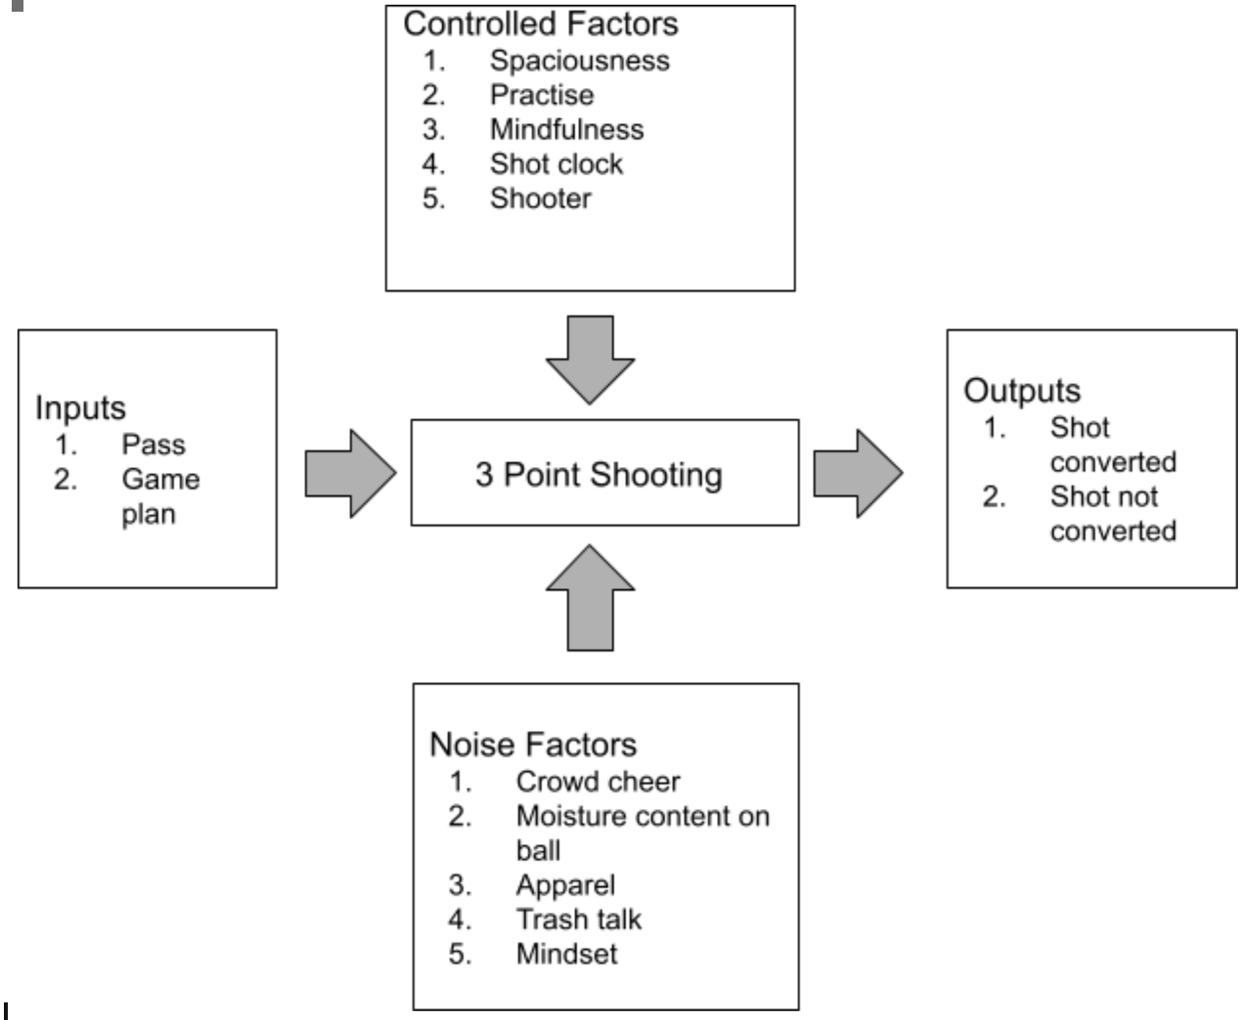
P- DIAGRAM

Slide 4
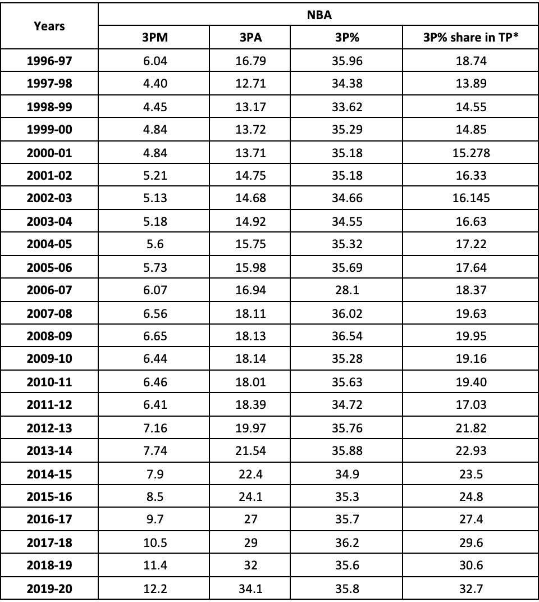
DATASET

Slide 5
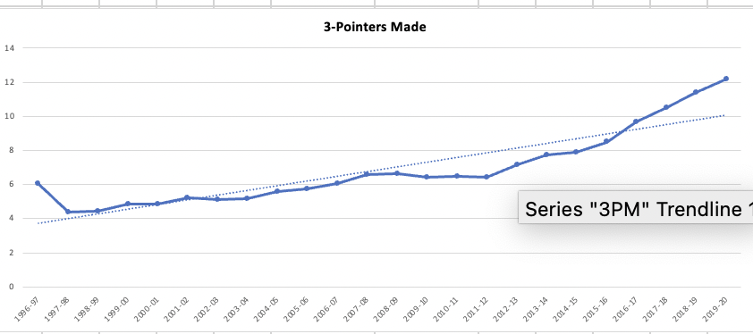
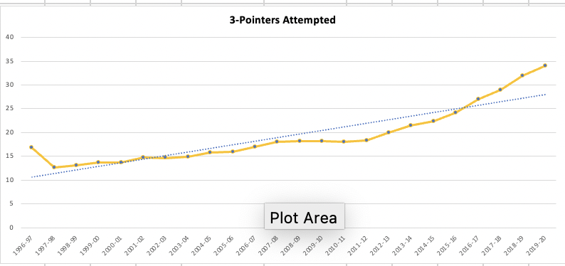
DATA ANALYSIS-Time series plot

Slide 6
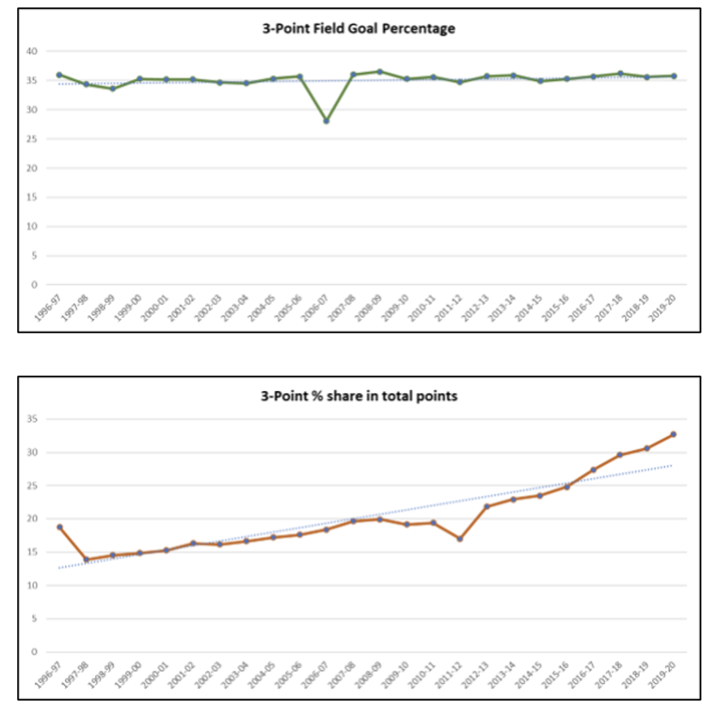
DATA ANALYSIS-Time series plot

Slide 7
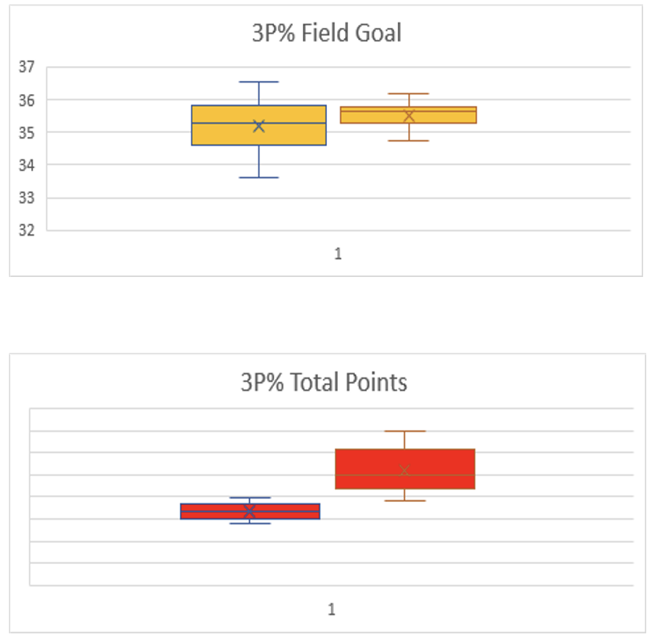
DATA ANALYSIS- BOX PLOT

Slide 8
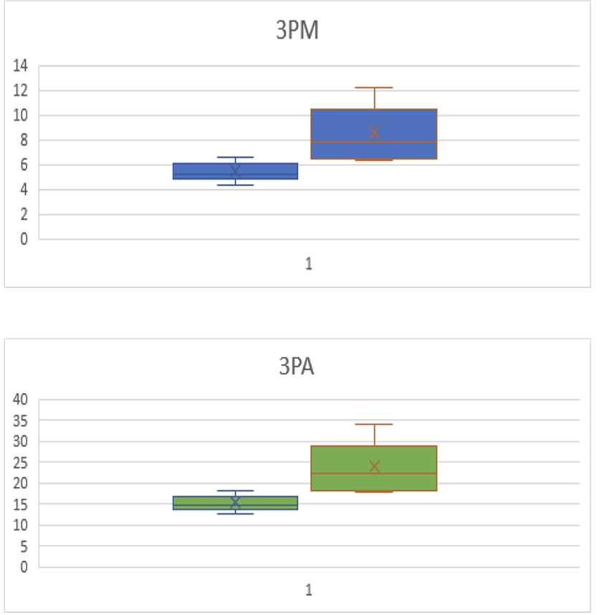
DATA ANALYSIS- BOX PLOT

Slide 9
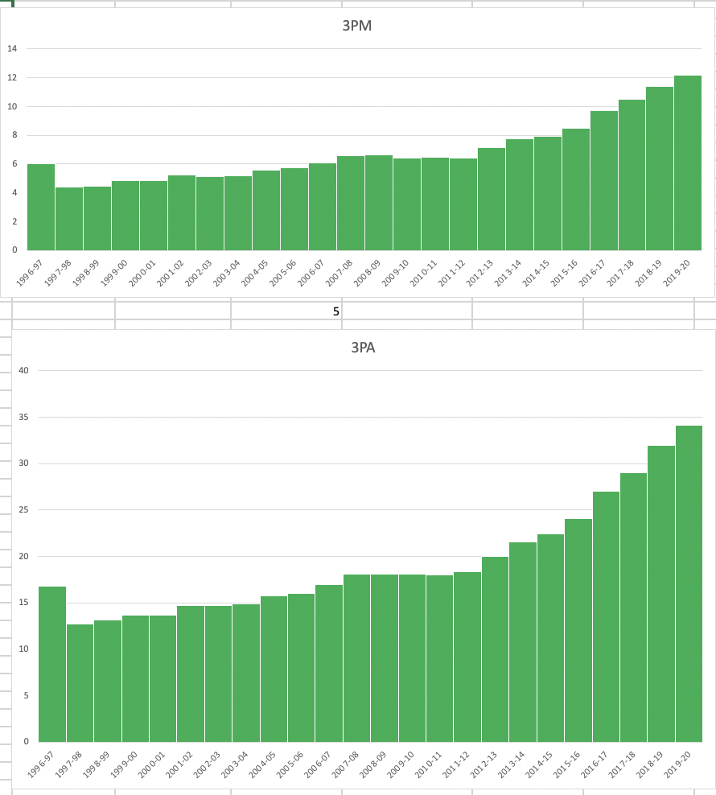
Data analysis- Histogram Analysis

Slide 10

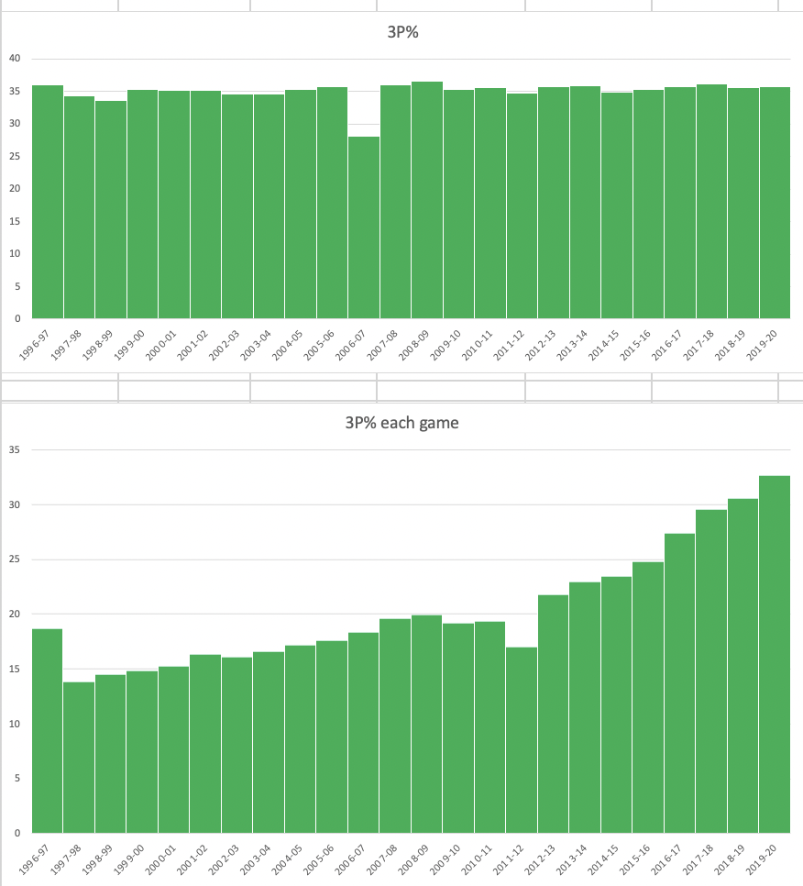

Slide 11
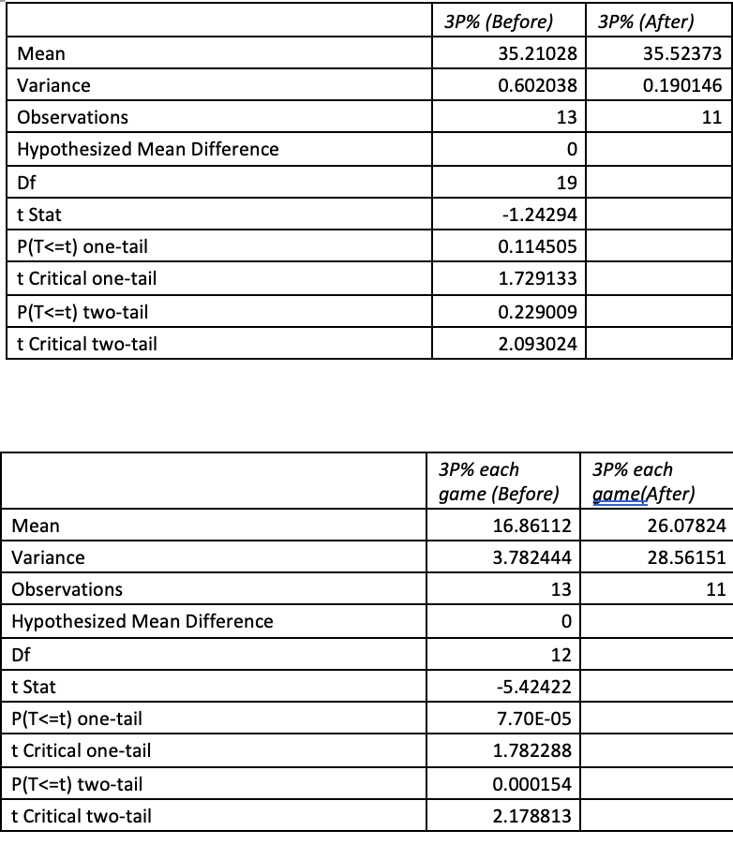
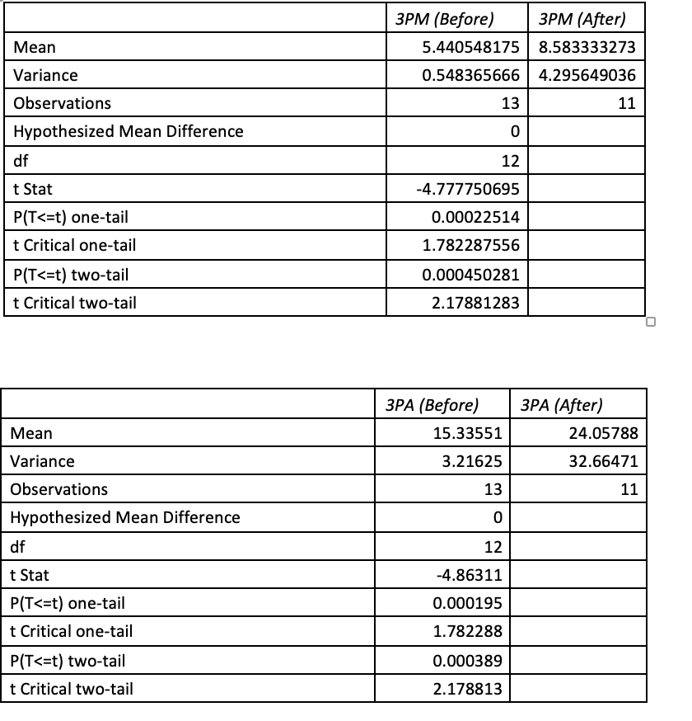
DATA ANALYSIS- t-TEST (Hypothesis testing)

Slide 12
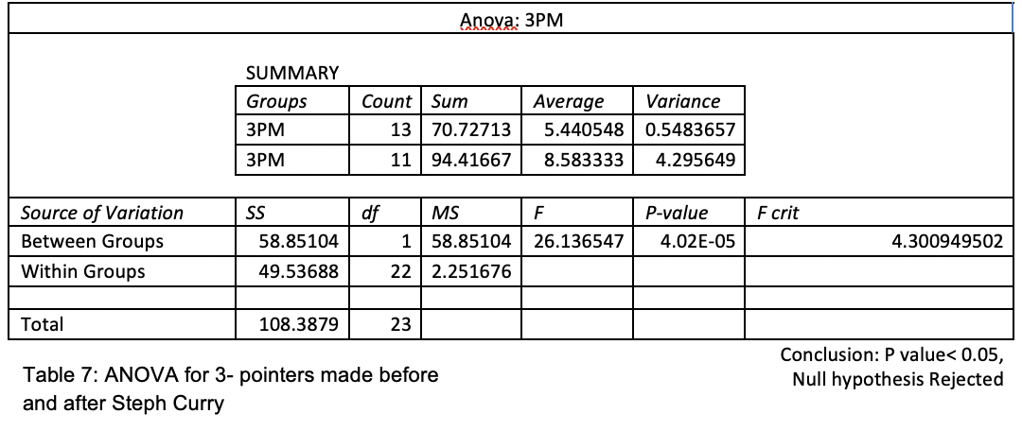
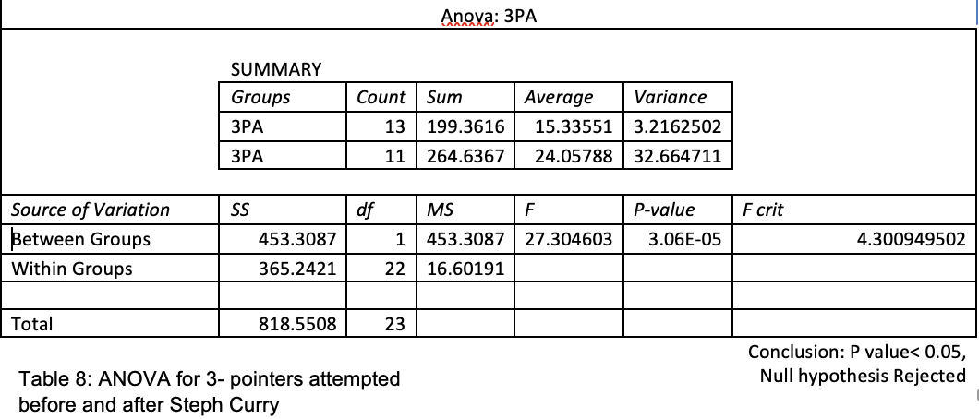
DATA ANALYSIS- Anova

Slide 13
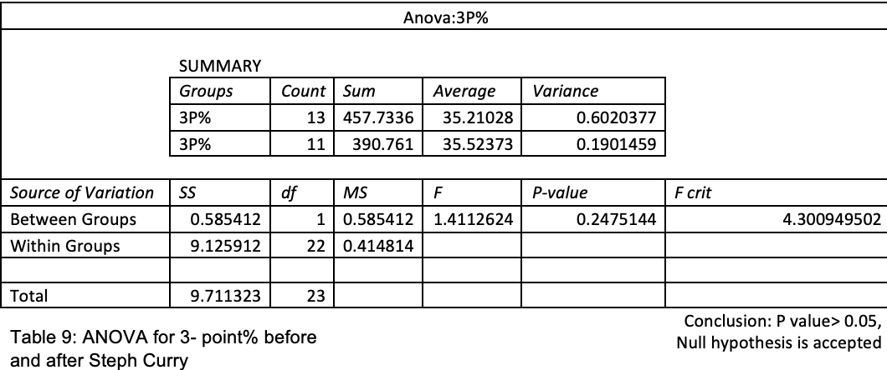
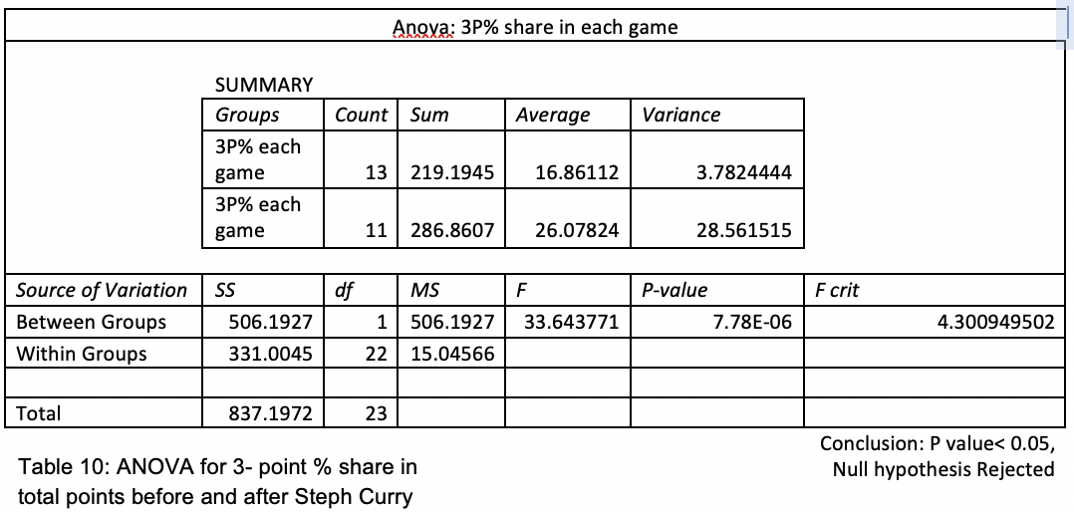
DATA ANALYSIS- Anova

Slide 14
RESULTS and Discussions
The p-value is minimal for three parameters which are 3 Pointers made, 3-pointers attempted, and percentage share of 3-pointers in total points, almost equivalent to 0. Since 0 < 0.05 ( α value), we reject the null hypothesis and accept the alternate hypothesis that at least one mean value is different.
A single ANOVA test conducted on a 3-pointer field goal percentage gave us a p-value of 0.248 > 0.05 ( α value), accepting the null hypothesis and indicating that the mean is almost similar.
Key Takeaways
The influence of Stephen Curry on 3-point shooting across the leagues was predominantly noticed starting season 2012-13 and after
Teams have started giving more importance to 3-point shooting in their game plan since Stephen Currys Introduction as a role player in Golden State warriors

Slide 15
References:
1) https://www.nba.com/stats/teams/traditional/?sort=W_PCT&dir=-1
2) https://en.wikipedia.org/wiki/Stephen_Curry
3) https://www.basketball-reference.com/players/c/curryst01.html

